Slide 1

Clean Code
Agile Software Craftmanship
By Vinanti Thakur
(Tech. Architect)
November 30, 2019

Slide 2
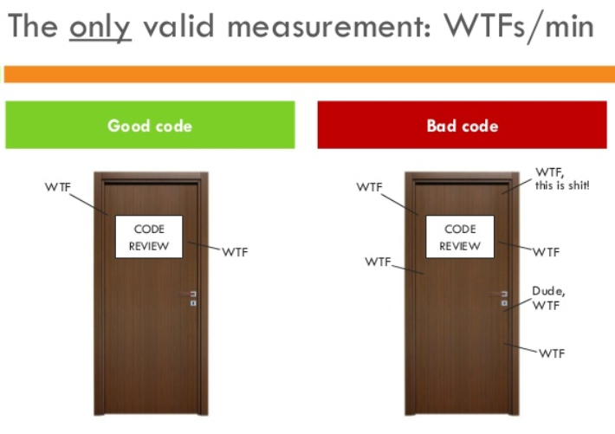
Introduction
Writing clean code is what you must do in order to call yourself a professional.
Clean code is subjective and every developer has a personal take on it.
There are some ideas that are considered best practice and what constitutes as clean code.
30 November 2019

Slide 3

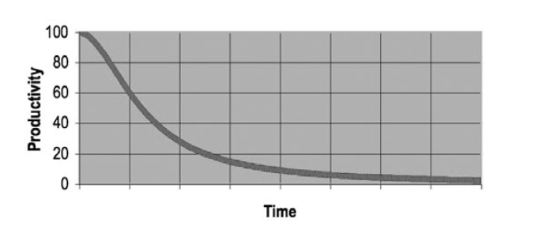
Why Clean Code..??
Reason 1: you are a Programmer.
Reason 2: you want to be a Better Programmer.
The Total cost if Owning a Mess!
30 November 2019

Slide 4
Goal: Code must be…
Readable
Maintainable
Extendable
Testable
30 November 2019

Slide 5

Meaningful Name
Naming Convention is an important in Architecture Modeling.
A naming convention is a set of rules for choosing the names which denote variables, types, functions, and other entities in your code.
Standard naming system must be define in Architectural/coding Document and set as standard.
30 November 2019

Slide 6


Meaningful Name
1. Use Intention- Revealing Name:
int d; //elapsed time in days
Int elapsedTimeInDays;
30 November 2019

Slide 7
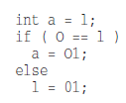
Meaningful Name
2. Avoid Disinformation:
30 November 2019

Slide 8

Meaningful Name
3. Make Meaningful Distinctions:
30 November 2019

Slide 9


Meaningful Name
4. Use Pronounceable Names:
30 November 2019

Slide 10
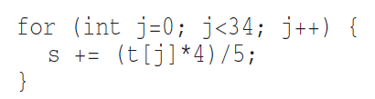
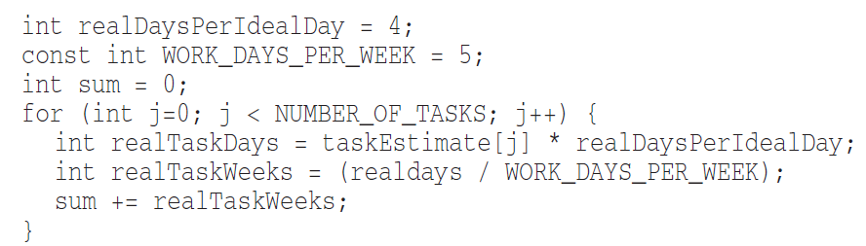
Meaningful Name
5. Use Searchable Names:
30 November 2019

Slide 11
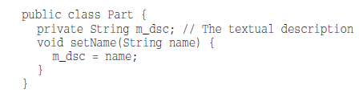
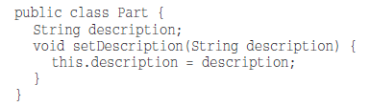
Meaningful Name
6. Avoid Encoding:
30 November 2019

Slide 12


Meaningful Name
7. Avoid Mental Mapping:
30 November 2019

Slide 13


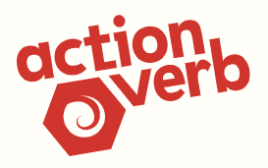

Meaningful Name
8. Class Names:
9. Method names:
30 November 2019

Slide 14
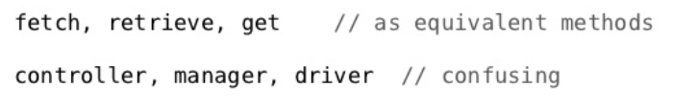
Meaningful Name
10. Pick One Word per Concept:
30 November 2019

Slide 15

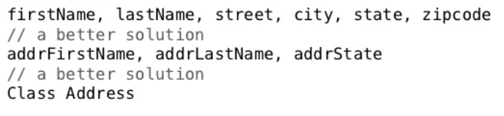
Meaningful Name
11. Use Solution Domain Names:
12. Add Meaningful Context:
30 November 2019

Slide 16
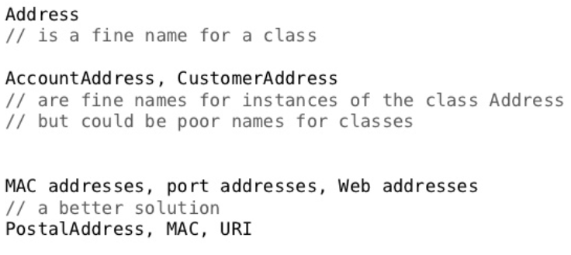
Meaningful Name
13. Don’t Add Gratuitous Context:
30 November 2019

Slide 17
Functions
Functions are the first line of organization in any program.
30 November 2019

Slide 18
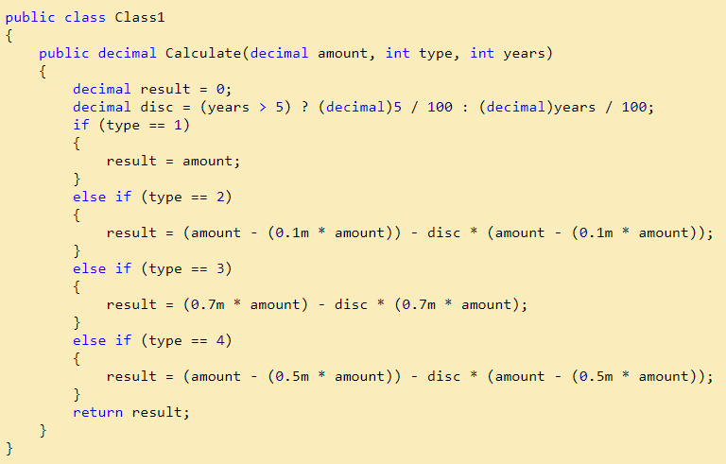
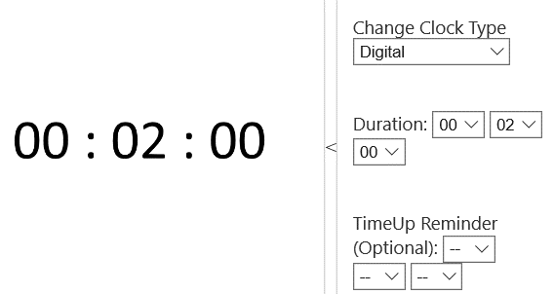
Functions
30 November 2019

Slide 19
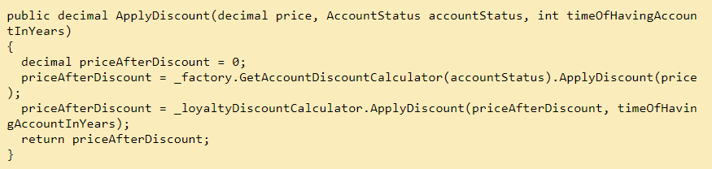
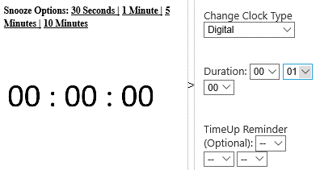
Functions
30 November 2019

Slide 20
Functions
Small!
Rules of writing functions()
Should be small
Should be smaller than small
Define rules in organization
< 150 characters / line
< 20 lines
Do One Thing
FUNCTIONS SHOULD DO ONE THING.
THEY SHOULD DO IT WELL.
THEY SHOULD DO IT ONLY.
30 November 2019

Slide 21
Functions
One Level of Abstraction per Function
a very high level of abstraction
getHtml();
an intermediate level of abstraction
String pagePathName = PathParser.render(pagePath);
low level of abstraction
.append("\n")
Mixing levels of abstraction within a function is always confusing.
The Stepdown Rule
Reading Code from Top to Bottom
30 November 2019

Slide 22
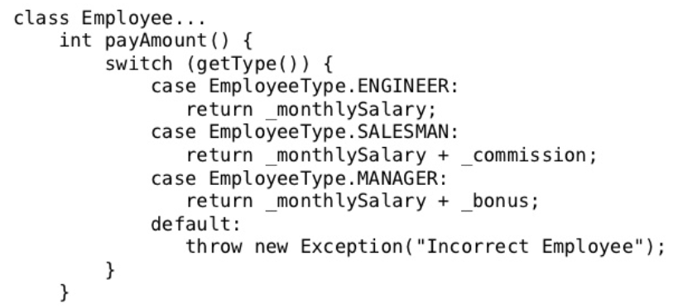
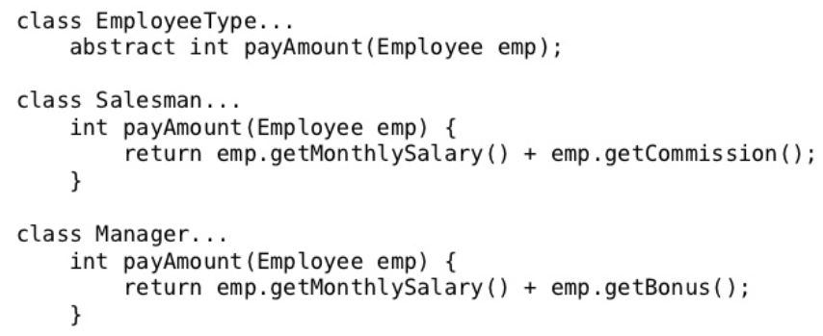
Functions
Switch Statements
By their nature, switch statements always do N things. Unfortunately
we can’t always avoid switch statements, but we can make sure that each switch
statement is buried in a low-level class and is never repeated by using Polymorphism.
30 November 2019

Slide 23
Functions
Use Descriptive Names
Don’t be afraid to make a name long. A long descriptive name is better than a short
enigmatic name.
A long descriptive name is better than a long descriptive comment.
Function Arguments
The ideal number of arguments for a function is zero (niladic).
Next comes one (monadic),
Followed closely by two (dyadic)
Three arguments (triadic) should be avoided where possible.
More than three (polyadic) requires very special justification and then shouldn’t be used anyway.
30 November 2019

Slide 24
Functions
Common Monadic Forms
There are two very common reasons to pass a single argument into a function.
You may be asking a question about that argument, as in boolean fileExists(“MyFile”).
you may be operating on that argument, transforming it into something else and returning it. For example, InputStream fileOpen(“MyFile”)
Flag Arguments
Flag arguments are ugly.
Passing a Boolean into a function is a truly terrible practice.
complicates the signature of the method – do one thing
It does one thing if the flag is true and another if the flag is false!
30 November 2019

Slide 25
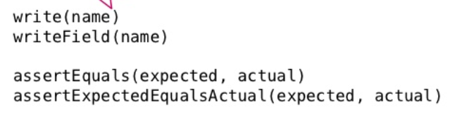
Functions
Argument Objects – Wrapping aurguments
Circle makeCircle(double x, double y, double radius);
Circle makeCircle(Point center, double radius);
Verbs and Keywords
30 November 2019

Slide 26
Functions
30 November 2019

Slide 27
Functions
Have No Side Effects
Output Arguments
Command Query Separation
Prefer Exceptions to Returning Error Codes
Extract Try/Catch Blocks
Error Handling Is One Thing
The Error.java Dependency Magnet
Don’t Repeat Yourself
Structured Programming
How Do You Write Functions Like This?
30 November 2019

Slide 28
Functions
30 November 2019

Slide 29
Functions
30 November 2019

Slide 30
Functions
30 November 2019

Slide 31
Functions
30 November 2019

Slide 32
Functions
30 November 2019

Slide 33
Functions
30 November 2019

Slide 34
Functions
30 November 2019

Slide 35
Functions
30 November 2019

Slide 36
Functions
30 November 2019

Slide 37
Functions
30 November 2019

Slide 38
Functions
30 November 2019

Slide 39
Functions
30 November 2019

Slide 40
Functions
30 November 2019

Slide 41
Functions
30 November 2019

Slide 42
Comments
30 November 2019

Slide 43
Formatting
30 November 2019

Slide 44
Object and data structure
30 November 2019

Slide 45
Error Handling
30 November 2019

Slide 46
Boundaries
30 November 2019

Slide 47
Unit Test
30 November 2019

Slide 48
Classes
30 November 2019

Slide 49
Systems
30 November 2019

Slide 50
Emergence
30 November 2019

Slide 51
Concurrency
30 November 2019

Slide 52

Thank You!!!
30 November 2019

